Slide 1
Church Data
HackACobber
Sam Garcia, Avash Shrestha & Theodore Yumba

Slide 2
Introduction
What we are creating for our client
Road map
Web database
Church data
Search feature and a security feature
Ability to add and modify data
Notes:
Sam

Slide 3
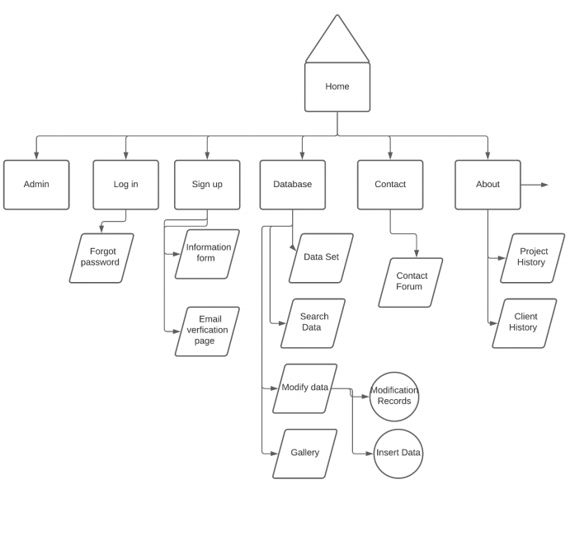
Work performed
Created a group contract
Contacted client
Met with our client
Created site map
Created a basic design
Notes:
Avash

Slide 4
What’s has gone well
-Client is active with communication
-Meeting as group
- Meeting with the client
- Making progress on the code
Notes:
Avash

Slide 5
Challenges faced
Usually bumps hiccups with small errors in code
Client isn’t familiar with technology
Notes:
Sam

Slide 6
Plan for remaining work
-Setting up host and domain
- convert raw data into the database
- Add more CSS
Notes:
Theo

Slide 7
Conclusion
-Demo
Notes:
Avash

